Slide 1

Large Language Models
Jeff Prosise
Chief Artificial Intelligence Officer
BS Mechanical Engineering UTK 1982
jeffrey.prosise@outlook.com
@jprosise

Slide 2

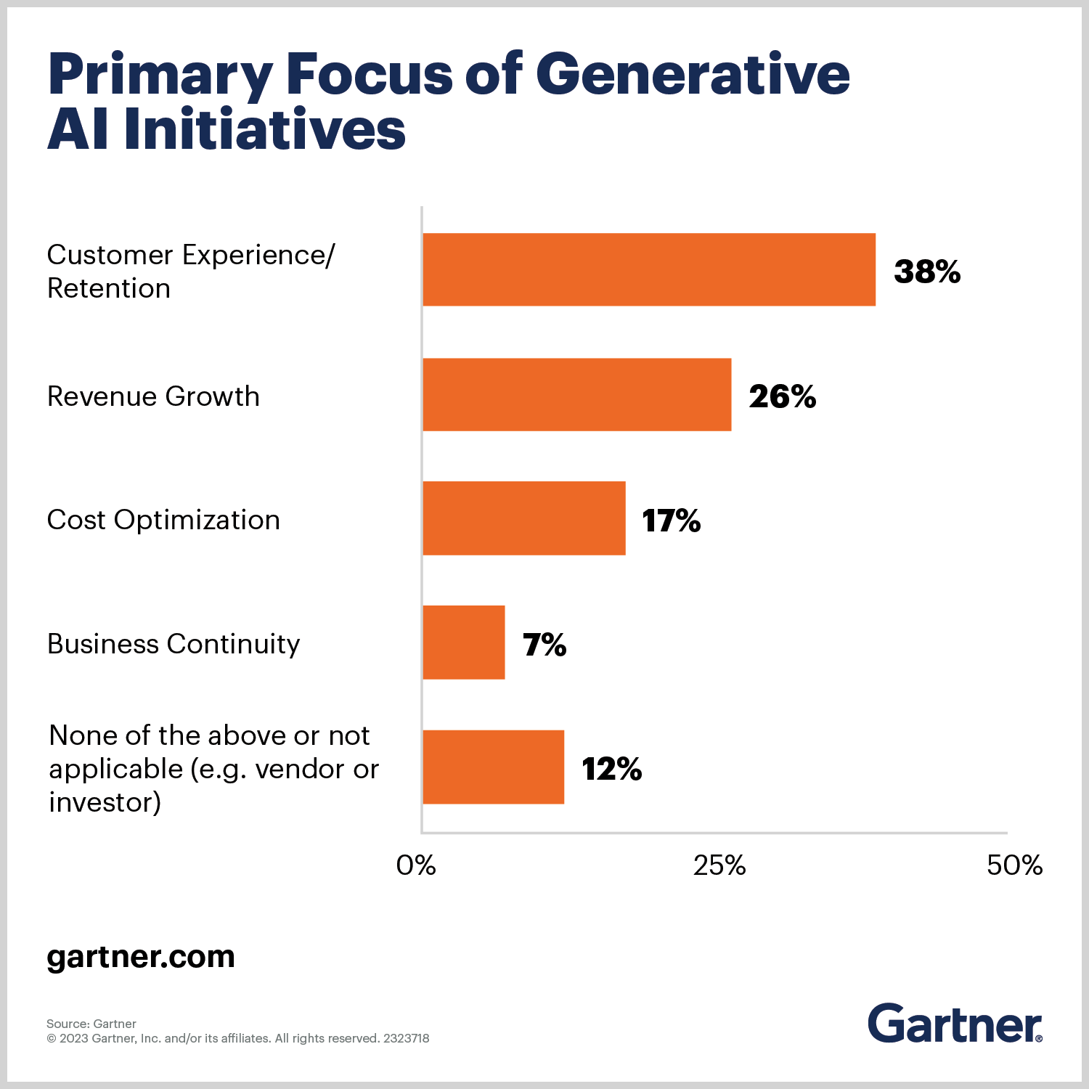

Why Generative AI?
Gartner sees generative AI becoming a general-purpose technology with an impact similar to that of the steam engine, electricity and the internet. The hype will subside as the reality of implementation sets in, but the impact of generative AI will grow as people and enterprises discover more innovative applications for the technology in daily work and life.
https://www.gartner.com/en/topics/generative-ai

Slide 3
Generating Text
Write a short story that begins with "It was a dark and stormy night."
It was a dark and stormy night. The wind was howling through the streets, making it difficult for anyone to stay on their feet. The rain was coming down in sheets, drenching anyone who dared to step outside. Inside, a young woman sat huddled in a corner of her small apartment, listening to the storm rage on outside.
She had always been afraid of storms, ever since she was a child. But tonight, there was something different about this one. It seemed to be getting closer and closer, and she could feel the panic rising in her chest. She tried to shake it off, telling herself that it was just a normal storm, but she couldn't shake the feeling that something was coming.
...

Slide 4
Translating Text
Translate the following into French: "What time does the train leave for Paris?"
"À quelle heure part le train pour Paris?"

Slide 5
Generating Code
Create a Python function that accepts an array of numbers as input, bubble sorts the numbers, and returns a sorted array
def bubble_sort(numbers):
# Get the length of the array
n = len(numbers)
# Traverse through all the array elements
for i in range(n-1):
# Last i elements are already in place
for j in range(0, n-i-1):
# Traverse the array from 0 to n-i-1
# Swap if the element found is greater than the next element
if numbers[j] > numbers[j+1]:
numbers[j], numbers[j+1] = numbers[j+1], numbers[j]
return numbers
Notes:
ChatGPT was trained on more than a billion lines of code from GitHub. It's proficient in more than 40 programming languages.

Slide 6
Translating Code
Translate the bubble_sort function into FORTRAN
FUNCTION bubble_sort(arr, n) RESULT(result)
...
DO i = 1, n
DO j = 1, n-i-1
IF (arr(j) > arr(j+1)) THEN
temp = arr(j)
arr(j) = arr(j+1)
arr(j+1) = temp
END IF
END DO
END DO
result = arr
END FUNCTION bubble_sort
Notes:
ChatGPT was trained on more than a billion lines of code from GitHub. It's proficient in more than 40 programming languages,

Slide 7
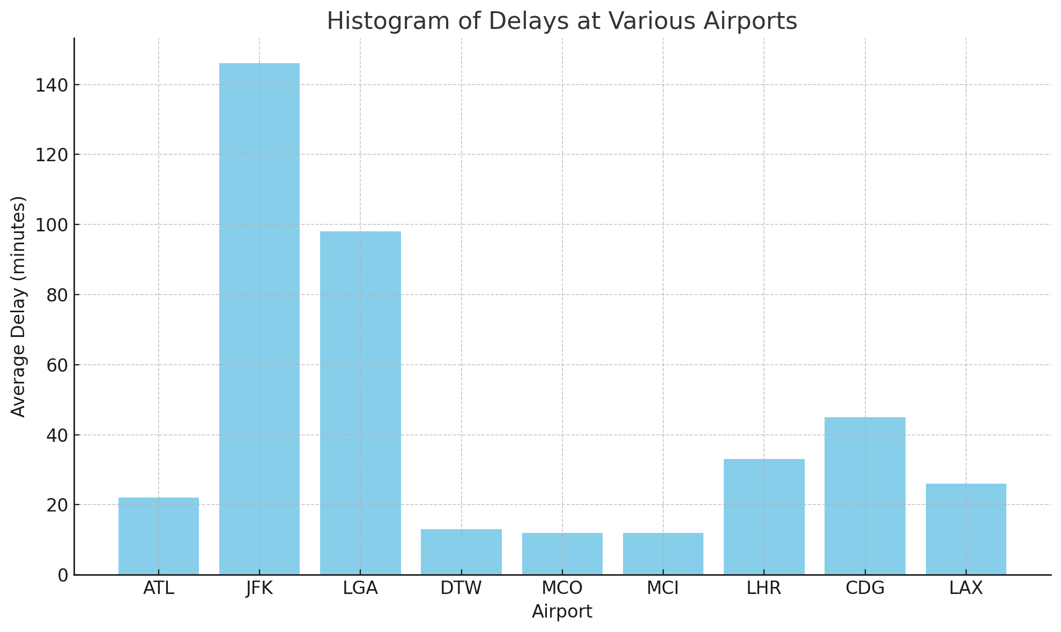
Generating Charts and Graphs
Generate a histogram from the attached CSV file showing delays at various airports
Airport | Average Delay
ATL | 22
JFK | 146
LGA | 98
DTW | 13
MCO | 12
MCI | 12
LHR | 33
CDG | 45
LAX | 26

Slide 8
Demo
Job Matching with LLMs
Notes:
Show DuckDuckCEO (https://duckduckceo.azurewebsites.net/).

Slide 9

Natural Language Processing (NLP)
Using deep-learning models to process human language
Capabilities have grown exponentially in recent years thanks to new neural architectures, including transformer encoder-decoders
Key concepts: Word embeddings, neural attention, and self-attention
Text and Document
Classification
Named
Entity
Recognition
Keyword Extraction
Question Answering
Neural Machine Translation
Notes:
It’s not difficult to use Scikit-learn to build machine-learning models that analyze text for sentiment, identify spam, and classify text in other ways. But today, state-of-the-art text classification is most often performed with neural networks. You already know how to build neural networks that accept numbers and images as input. Let’s build on that to learn how to construct deep-learning models that process text – a segment of deep learning known as natural language processing, or NLP for short.
NLP encompasses a variety of activities including text classification, named-entity recognition, keyword extraction, question answering, and language translation. The accuracy of NLP models has improved in recent years for a variety of reasons, not the least of which are newer and better ways of converting words and sentences into dense vector representations that incorporate meaning, and a relatively new neural-network architecture called the transformer that can zero in on the most meaningful words and even differentiate between different meanings of the same word.
One element that virtually all neural networks that process text have in common is an embedding layer, which use word embeddings to transform arrays, or sequences, of scalar values representing words into arrays of word vectors. These vectors encode information about the meaning of words and relationships between them. Output from an embedding layer can be input to a classification layer, or it can be input to other types of layers to tease more meaning from it before subjecting it to further processing.
Transformers? Embedding layers? Word vectors? There’s a lot to unpack here, but once you wrap your head around a few basic concepts, neural networks that process language are pure magic. Let’s dive in. We’ll start by learning how to prepare text for processing by a deep-learning model and how to create word embeddings. Then we’ll put that knowledge to work building neural networks that classify text, translate text from one language to another, and more – all classic applications of NLP.

Slide 10
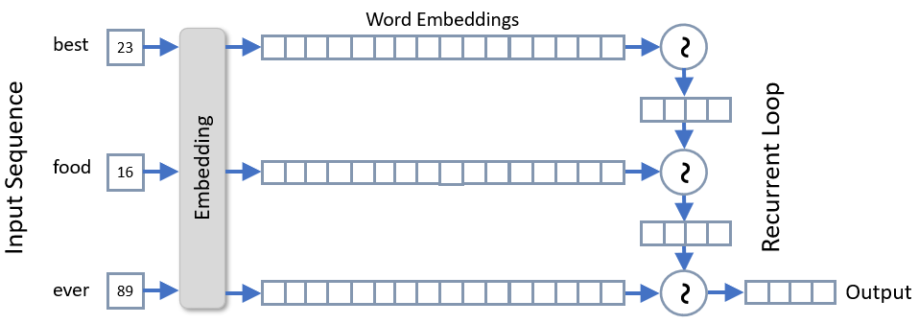
Recurrent Neural Networks (RNNs)
Tokenized phrase is input to the embedding layer as a sequence of word indexes
Each token is converted into a word embedding, which is an array (vector) of floating-point values modeling each word's relationship to other words
A recurrent layer loops through the word embeddings in the sequence, computing a value for each that factors in the output from the previous iteration
Notes:
Another way to factor word position into a classifier is to include recurrent layers in the network. Recurrent layers were originally invented to process time-series data – for example, to look at weather data for the last five days and predict what tomorrow’s high temperature will be. If you simply took all the weather data for the last five days and treated each day independently, trends evident in the data would be lost. A recurrent layer, however, might detect those trends and factor them into its output. A sequence of vectors output by an embedding layer qualifies as a time series because words in a phrase are ordered consecutively and words used early in a phrase could inform how words that occur later are interpreted.
The diagram on this slide illustrates how a recurrent layer transforms word embeddings into a vector that’s influenced by word positions. In this example, sequences are input to an embedding layer, which transforms each word (token) in the sequence into a vector of floating-point numbers. These word embeddings are input to a recurrent layer, yielding another output vector. To compute that vector, cells in the recurrent layer (analogous to neurons in a dense layer) loop over the word embeddings comprising the sequence. The input to iteration n+1 of the loop is the current embedding vector and the output from iteration n – the layer’s so-called hidden state. The output from the recurrent layer is the output from the final iteration of the loop. The result is different than it would have been had each embedding vector been processed independently because each iteration uses information from the previous iteration to compute an output. In effect, context from a word early in a sequence can carry over to words that occur later on.

Slide 11
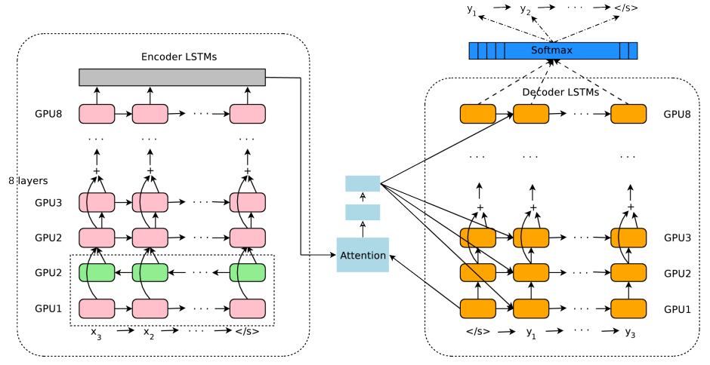
Google Translate circa 2016
Source: "Google's Neural Machine Translation System: Bridging the Gap between Human and Machine Translation" (https://arxiv.org/abs/1609.08144)
Notes:
This illustration comes from a 2016 paper written by Google engineers documenting the architecture of Google Translate. The architecture maps closely to that of the model on the previous slide. It’s deeper, with eight LSTM layers (one of them bidirectional) in the encoder and eight in the decoder. It also employs residual connections between layers to support the network’s greater depth, and an "attention" module between the decoder and encoder.
Neural attention was introduced in 2014 paper entitled "Neural Machine Translation by Jointly Learning to Align and Translate." An attention module (or layer) gives an LSTM decoder access to all the vectors output by the cells in the final layer of an LSTM encoder. (Normally, the decoder only sees one vector from the encoder's final layer.) Attention also provides additional context for each word predicted by the decoder. The attention module learns as network is trained, just as an Embedding layer learns during training. Keras lacks an Attention layer, but one is available at https://github.com/philipperemy/keras-attention-mechanism.

Slide 12
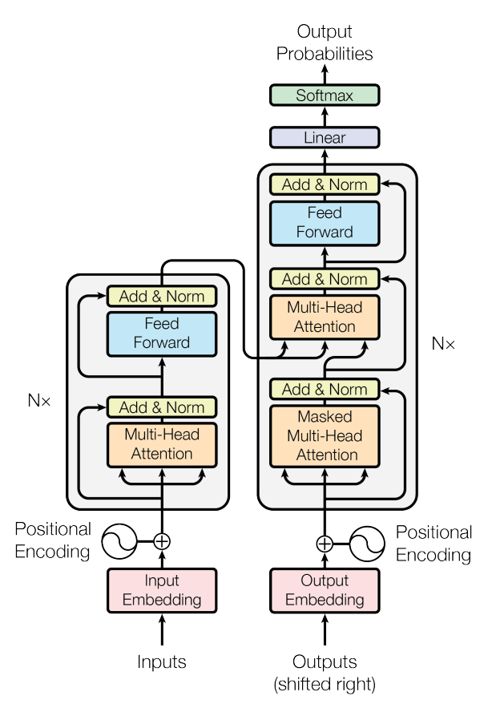
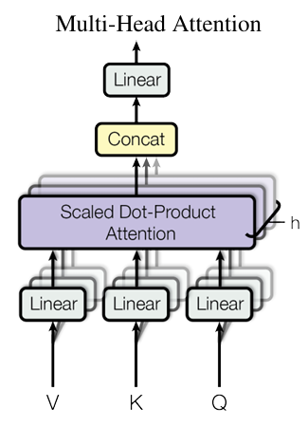
Transformers
Introduced in 2017 paper "Attention is All You Need"
Multi-head attention layers extract meaning from text
Discern between different meanings of the same word (polysemy)
Connect pronouns to subjects
Train in parallel and connect words independent of distance
Notes:
A landmark 2017 paper entitled “Attention Is All You Need” changed the way data scientists approach NMT and other neural text-processing tasks. It proposed a better way to perform sequence-to-sequence processing based on transformer models that eschew recurrent layers and use attention mechanisms to model the context in which words are used. Today, transformer models have almost entirely replaced LSTM-based encoders-decoders for translating text.
The diagram on this slide from the aforementioned paper. On the left is the encoder, which takes text sequences as input and generates dense vector representations of those sequences. On the right is the decoder, which transforms dense vector representations of input sequences into output sequences. At a high level, a transformer model uses the same encoder-decoder architecture as an LSTM-based model. The difference lies in how it does the encoding and decoding.
The chief innovation introduced by the transformer model is the use of multi-head attention (MHA) layers in place of LSTM layers. MHA layers embody the concept of self-attention, which enables a model to analyze an input sequence and focus on the words that are most important as well as the context in which the words are used. In the sentence “We took a walk in the park,” for example, the word “park” has a different meaning than it does in “Where did you park the car?” An embedding layer stores one vector representation for “park,” but in a transformer model, the MHA layer modifies the vector output by the embedding layer so that “park” is represented by two different vectors in the two sentences.
MHA also provides additional context regarding words that refer to other words. An embedding layer represents the pronoun “it” with a single vector, but an MHA layer helps the model understand that in the sentence “I love my car because it is fast,” “it” refers to a car. It also adds weight to the word “fast” because it’s crucial to the meaning of the sentence. Without it, it’s not clear why you love your car.
MHA layers are superior to LSTM layers because they add context to the words and phrases being translated. MHA layers do not, however, encode information regarding the positions of the words in a phrase. To compensate, a transformer uses simple vector addition to add information denoting a word’s position in a sequence to each vector output from the embedding layer. This is referred to as positional encoding or positional embedding.
Transformers offer two big advantages over RNNs: attention heads in an attention layer can be trained in parallel, and a transformer can connect words together in text of any length. RNNs, by contrast, require sequential training, and their ability to connect words in a text sample diminishes as the distance between words increases.

Slide 13
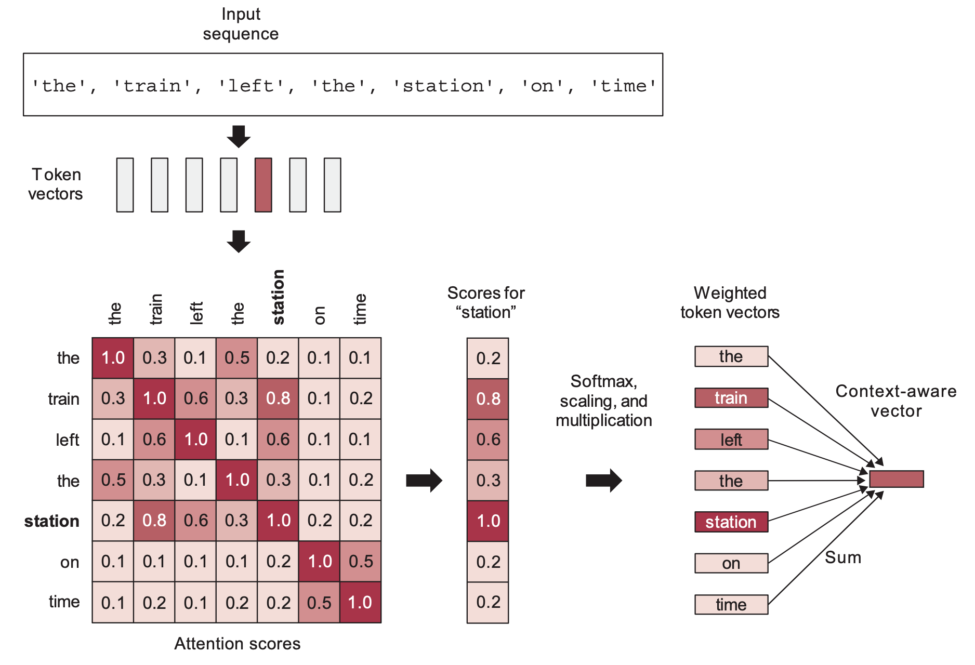
Self-Attention
Source: "Deep Learning with Python" by Francois Chollet (2021, Manning Publications)
Notes:
A multi-head attention layer consists of two or more self-attention heads. The big idea behind self-attention is that it turns a fixed word embedding into a context-aware word embedding by computing the dot product of each pair of word embeddings and producing a new word embedding that is the weighted sum of all the word embeddings. In this example, the vector for "station" is modified to include elements of the "train" vector, indicating that it's not just a station, but a train station. Each self-attention head uses a set of weights learned during training to analyze a text sample in different ways and connect different parts of it together. ChatGPT has 96 attention layers with 96 heads each. That means each layer can look at a text sample 96 different ways. The input to the first attention layer is the word embeddings with positional information added. The input to successive attention layers is the output from the previous layer.

Slide 14
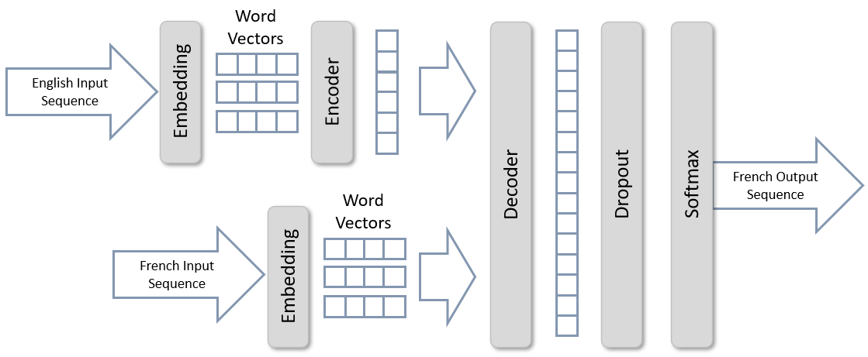
Neural Machine Translation
The model has two inputs: one for tokenized English input, and another for tokenized French input. Embedding layers translate each into word vectors.
The decoder translates the inputs into an output sequence, and a softmax output layer predicts the next word in the French sequence. The next word is appended to the text predicted thus far and fed back into the model to predict the next word. The cycle repeats until the entire English phrase has been translated.
Notes:
The model includes two embedding layers: one for each of two inputs. Both convert word tokens into word vectors, and both are instances of Keras-NLP’s TokenAndPositionEmbedding class, which adds positional information to word embeddings. Output from the English embedding layer passes through an encoder (an instance of TransformerEncoder) before being input along with the output from the French embedding layer to the decoder, which is an instance of TransformerDecoder. The decoder converts the two inputs into a dense vector representing the French phrase predicted from the inputs. The softmax layer at the end outputs probabilities for each word in the French vocabulary for each position in the output sequence, and the dropout layer preceding it prevents the model from fitting too tightly to the training data. Crucially, the combination of the mask_zero=True parameter in the embedding layer and the use_causal_mask=True parameter passed to the decoder limit the model to making predictions based only on the French text that has been translated thus far.
The model operates iteratively. To translate text, you first pass an entire English phrase to the English input and the word “[start]” to the French input. Then you append the next French word the model predicts to the previous French input and call the model again, and you repeat this process until the entire phrase has been translated. In deep learning, this is known as an autoregressive model.

Slide 15
Implementing a Transformer Encoder-Decoder
encoder_input = Input(shape=(None,), dtype='int64', name='encoder_input')
x = TokenAndPositionEmbedding(en_vocab_size, sequence_len, 256)(encoder_input)
encoder_output = TransformerEncoder(256, 8)(x)
encoded_seq_input = Input(shape=(None, 256))
decoder_input = Input(shape=(None,), dtype='int64', name='decoder_input')
x = TokenAndPositionEmbedding(fr_vocab_size, sequence_len, 256, mask_zero=True)(decoder_input)
x = TransformerDecoder(256, 8)(x, encoded_seq_input)
x = Dropout(0.4)(x)
decoder_output = Dense(fr_vocab_size, activation='softmax')(x)
decoder = Model([decoder_input, encoded_seq_input], decoder_output)
decoder_output = decoder([decoder_input, encoder_output])
model = Model([encoder_input, decoder_input], decoder_output)
KerasNLP Classes
Embedding Dimension
Number of Heads
Notes:
This example uses Keras's functional API; it has to because the model has two inputs. The functional API is a richer version of Keras’s sequential API. Among other things, it lets you create models with multiple inputs or outputs and models with shared layers like the ones in Faster R-CNN’s region proposal network. Here’s a simple neural network for binary classification defined with the sequential API:
model = Sequential()
model.add(Dense(128, activation='relu', input_dim=3))
model.add(Dense(1, activation='sigmoid'))
Here’s the same network created with the functional API:
input = Input(shape=(3,))
hidden = Dense(128, activation='relu')(input)
output = Dense(1, activation='sigmoid')(hidden)
model = Model(inputs=input, outputs=output)
The double-parentheses syntax – for example, Dense(…)(…) – is somewhat off-putting at first. You rarely see it, and yet it’s perfectly legitimate Python. It first calls the class constructor (internally, the class’s __init__ function), and then calls the class’s __call__ function. The latter connects the layer __call__ is called on to the layer specified as a function parameter.
When you create the model, you specify the inputs and outputs, and since the inputs and outputs parameter will accept Python lists, it’s a simple matter to create a model with multiple inputs and outputs. For a concise introduction to the functional API and examples demonstrating advanced uses, including multiple inputs and outputs and shared layers, see “How to Use the Keras Functional API for Deep Learning.“

Slide 16
Translating Text
hello
world
[start]
salut (65.05%)
bonjour (18.31%)
change (3.88%)
faites (0.76%)
bravo (0.73%)

Slide 17
Translating Text, Cont.
hello
world
[start]
salut
le (83.57%)
les (5.76%)
des (3.77%)
du (1.69%)
[end] (1.61%)

Slide 18
Translating Text, Cont.
hello
world
[start]
salut
le
monde (98.47%)
ton (0.13%)
credule (0.08%)
bon (0.08%)
record (0.06%)

Slide 19
Translating Text, Cont.
hello
world
[start]
salut
le
monde
[end] (99.18%)
est (0.53%)
se (0.08%)
a (0.04%)
le (0.03%)

Slide 20
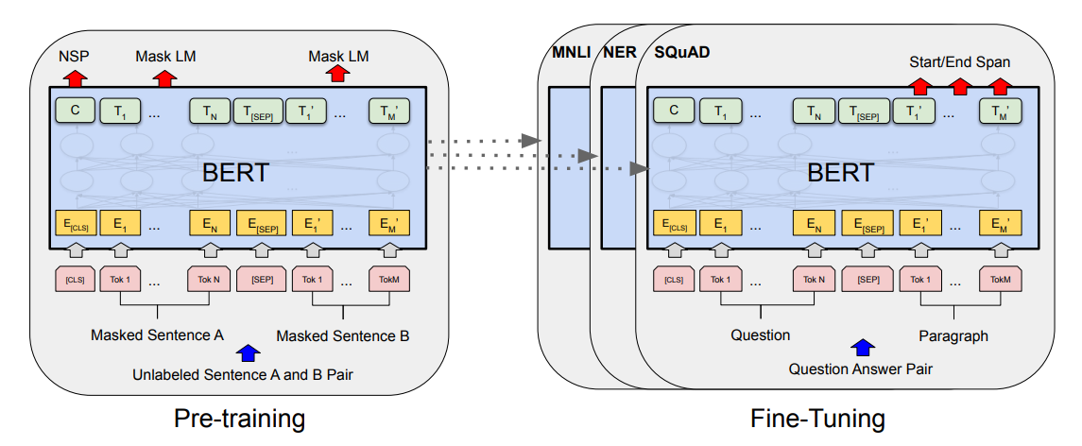
BERT
Bidirectional Encoder Representations from Transformers (BERT)
Built by Google and instilled with language understanding by pretraining with billions of words and phrases
Can be fine-tuned to perform a variety of NLP tasks
Notes:
The introduction of transformers in 2017 laid the groundwork for another landmark innovation in the NLP space: Bidirectional Encoder Representations from Transformers, or BERT for short. Introduced by Google researchers in a 2018 paper titled “BERT: Pre-training of Deep Bidirectional Transformers for Language Understanding,” BERT advanced the state of the art by providing pretrained transformers that can be fine-tuned for a variety of NLP tasks.
BERT was instilled with language understanding by training it with more than 2.5 billion words from Wikipedia articles and 800 million words from Google Books. Training required four days on 64 tensor processing units (TPUs). Fine-tuning is accomplished by further training the pretrained model with task-specific samples and a reduced learning rate (Figure 13-7). It’s a relatively simple matter, for example, to fine-tune BERT to perform sentiment analysis and outscore bag-of-words models for accuracy. BERT’s value lies in the fact that it possesses an innate understanding of the languages it was trained with and can be refined to perform domain-specific tasks.
BERT has been called the “Swiss army knife” of NLP. Google uses it to improve search results and predict text as you type a Gmail or Google Doc. Dozens of variations have been published, including DistilBERT, which retains 97% of the accuracy of the original model while weighing in 40% smaller and running 60% faster. Also available are variations of BERT already fine-tuned for specific tasks such as question answering. Such models can be further refined using domain-specific datasets, or they can be used as-is.

Slide 21
Masked Language Modeling (MLM)
Turns unlabeled text into training ground for language structure
During training, a specified percentage (usually 15%) of the tokens are randomly masked (dropped) from the training sequences, and the model is trained to predict the missing words
?
and
seven
years
?
our
fourscore
fourscore
and
and
seven
?
years
years
ago
ago
our
our
fathers
?
forth
on
this
continent
fathers
fathers
brought
brought
forth
forth
?
on
this
this
continent
continent
a
new
?
conceived
in
liberty
a
a
new
?
nation
nation
conceived
conceived
in
in
?
liberty
and
dedicated
?
the
proposition
?
and
and
dedicated
?
to
to
the
the
?
proposition
that
that
Notes:
Aside from the fact that it was trained with a huge volume of text, the key to BERT’s ability to understand human language is an innovation known as Masked Language Modeling. MLM turns a large corpus of text into a training ground for learning the structure of a language. When BERT models are pretrained, a specified percentage of the words in each batch of text – usually 15% – are randomly removed or “masked” so the model can learn to predict the missing words from the words around them. Unidirectional models look at the text to the left or the text to the right and attempt to predict what the missing word should be. MLM uses text on the left and right to inform its decisions. That’s why BERT is a “bidirectional” transformer. A model has a better chance of predicting what word should fill in the blank in the phrase “Every good ____ does fine” than it has at predicting the next word in the phrase “Every good ____.” The answer could be boy, as in “Every good boy does fine,” or it could be turn, as in “Every good turn deserves another.” Or it could be something else entirely.

Slide 22
OpenAI
Creator of ChatGPT, DALL·E, and other cutting-edge models
Offers REST APIs for generating text, images, code, and text embeddings, for converting speech to text, and more
GPT
DALL·E
Embeddings
Whisper
TTS
Models that support text and code generation. Includes ChatGPT and GPT-4.
Produces images from natural-language prompts. Supports inpainting, outpainting, image variations, and more.
Models that generate embedding vectors from text. Used for semantic search, recommender systems, and more.
General-purpose speech-to-text engine trained on 680,000 hours of audio. Also available via open source.
Converts text to speech. One version is optimized for speed, while the other version is optimized for quality.
Notes:
Whisper can transcribe audio into dozens of languages and optionally transcribe to English. The GPT 3.5 models supercede the GPT-3 models. One justification for using GPT-3 is that those models support fine-tuning, while GPT-3.5 models do not (at least not yet). Interestingly enough, ChatGPT can be used for code generation just like the Codex models.

Slide 23
The Road to ChatGPT
2017
2018
2020
2022
GPT-1
GPT-2
Transformer
BERT
GPT-3
ChatGPT
Neural architecture for NLP models that replaced recurrent neural networks (RNNs). Transformers use self-attention to connect related words in a sequence and can process sequences of any length.
Transformer-based model pretrained on more than 3 billion words from Wikipedia and Google Books using Masked Language Modeling. Can be fine-tuned to perform specific NLP tasks such as Neural Machine Translation.
Large Language Model (LLM) similar to BERT but trained on 500 billion words from the Internet. 10 times larger than any neural network previously built, featuring 175 billion parameters. Performs certain NLP tasks without fine-tuning.
Fine-tuned version of GPT-3.5. Further refined using Reinforcement Learning from Human Feedback (RLHF). Does everything GPT-3.5 does (and more) at 1/10th the cost. Made available via API on March 1st, 2023.
Notes:
The primary version of BERT features 345 million parameters. GPT-1 has 117 million parameters, while GPT-2 has 1.2 billion. GPT-4 is rumored to have 100 trillion parameters (https://uxplanet.org/gpt-4-facts-rumors-and-expectations-about-next-gen-ai-model-52a4ddcd662a). ChatGPT was made available by API on March 1st, 2023. https://datascience.stackexchange.com/questions/118260/chatgpts-architecture-decoder-only-or-encoder-decoder/118262#118262

Slide 24
How ChatGPT was Created
Fine-tune GPT-3 with 13,000 supervised-learning samples. Each sample consists of a prompt (for example, "write a short story that begins with…") generated manually or selected from actual inputs to the GPT-3 API and a response generated by humans.
Step 1: Supervised Fine-Tuning
Use the model fine-tuned in Step 1 to generate several responses for each of tens of thousands of prompts. Manually rank each set of responses from best to worst and train a reward model with the labeled dataset.
Step 2: Reward Model
Input a prompt to the model. Use the reward model to score the resulting response for quality/desirability. Feed the score back in to the model and use Proximal Policy Optimization (PPO) to fine-tune the model's behavior. Do this repeatedly until fine-tuning is complete.
Step 3: Reinforcement Learning
Notes:
OpenAI hired 40 contractors to write the responses used in Step 1. Presumably, the same contractors were used to manually rank responses in Step 2.

Slide 25
How ChatGPT Works
temperature=0.0
complete
the
sentence
"every
good"
thing (66.5%)
must (47.8%)
come (99.9%)
to (100.0%)
an (100.0%)
end (100.0%)
story (22.2%)
has (36.1%)
eventually (0.1%)
an (0.0%)
and (0.0%)
deed (10.0%)
comes (15.4%)
comes (0.0%)
<END> (0.0%)
end (0.0%)
action (0.5%)
starts (0.3%)
end (0.0%)
a (0.0%)
plan (0.3%)
in (0.2%)
someday (0.0%)
thing
must
come
to
an
end

Slide 26
How ChatGPT Works, Cont.
temperature=0.7
complete
the
sentence
"every
good"
thing (66.5%)
must (47.8%)
an (67.3%)
time (38.6%)
story (22.2%)
has (36.1%)
its (31.2%)
own (21.8%)
deed (10.0%)
comes (15.4%)
a (0.6%)
price (20.0%)
action (0.5%)
starts (0.3%)
to (0.3%)
opposite (6.3%)
plan (0.3%)
in (0.2%)
it (0.0%)
season (3.0%)
thing
has
its
price

Slide 27
Generating Text with the ChatGPT API
from openai import OpenAI
client = OpenAI(api_key='OPENAI_API_KEY')
messages = [{ 'role': 'user', 'content': 'Write a poem about deep learning' }]
response = client.chat.completions.create(
model='gpt-3.5-turbo',
messages=messages
)
print(response.choices[0].message.content)
Notes:
This code does the same thing as the code on the previous slide at 1/10th the cost. gpt-3.5-turbo costs much less than text-davinci-003 because OpenAI reduced their cost through heavy optimization, and they pass that savings on to the consumer.

Slide 28
Specifying the Temperature
client = OpenAI(api_key='OPENAI_API_KEY')
messages = [{ 'role': 'user', 'content': 'Write a poem about deep learning' }]
response = client.chat.completions.create(
model='gpt-3.5-turbo',
messages=messages,
temperature=0.2
)
print(response.choices[0].message.content)
Notes:
This code does the same thing as the code on the previous slide at 1/10th the cost. gpt-3.5-turbo costs much less than text-davinci-003 because OpenAI reduced their cost through heavy optimization, and they pass that savings on to the consumer.

Slide 29
Demo
ChatGPT
Notes:
Show the first half of ChatGPT.ipynb

Slide 30
Retrieval-Augmented Generation (RAG)
Use LLMs to answer questions using documents as context
"Chunk" documents and use embeddings to identify relevant chunks
LLM
Vector Database
Answer the following question from the provided context. If you don't know the answer, say "I don't know."
QUESTION: How much revenue did Microsoft generate in 2023?
CONTEXT:

Slide 31
Answering Contextual Questions
content = f'''
Answer the following question using the provided context, and if the answer isn't
contained in the context, say "I don't know:"
Context: {context} # Insert text to be searched for an answer
Question: How much revenue did Microsoft generate in 2023?
Answer:
'''
messages = [{ 'role': 'user', 'content': content }]
response = client.chat.completions.create(
model='gpt-3.5-turbo',
messages=messages
)
Notes:
Used this way, ChatGPT limits the scope of its answers to the context provided. It's even capable of saying "I don't know."

Slide 32
OpenAI Embeddings API
Generates high-quality embedding vectors from text
text-embedding-ada-002 model is best and most cost-effective
Generates vectors of 1,536 floating-point numbers and is applicable to long and short text samples, replacing earlier models that were sensitive to text length
Compute similarity between two text samples by generating embeddings for each and computing the dot product
Useful for semantic-search systems, recommender systems, deduplication systems, and other similarity-based systems
Combine with vector databases such as Pinecone or ChromaDB to create systems that scale to millions of embedding vectors
Notes:
Earlier versions of the Embedding API featured separate models for vectorizing short text samples and long text samples. text-embedding-ada-002 is effective at vectorizing text samples regardless of length.

Slide 33
Generating an Embedding Vector
from openai import OpenAI
client = OpenAI(api_key='OPENAI_API_KEY')
response = client.embeddings.create(
model='text-embedding-ada-002',
input='Four score and seven years ago our fathers brought forth, ' \
'upon this continent, a new nation, conceived in liberty, and ' \
'dedicated to the proposition that all men are created equal'
)
embedding = response.data[0].embedding
# [0.010711653158068657, -0.022770840674638748, -0.02682592160999775, ...]

Slide 34
Comparing Embedding Vectors
x = client.embeddings.create(
model='text-embedding-ada-002',
input='One way to combat overfitting is to introduce a Dropout layer'
).data[0].embedding
y = client.embeddings.create(
model='text-embedding-ada-002',
input='Another strategy is to reduce the width of the Dense layer'
).data[0].embedding
similarity = np.dot(np.array(x), np.array(y))
# 0.850507216173648
Notes:
Computing the dot product of two embedding vectors yields a score from 0.0 to 1.0 quantifying how similar the vectors are.

Slide 35
Demo
ChatGPT Over Documents
Notes:
Retrieval-Augmented Generation.ipynb

Slide 36
Generating a SQL Query
Generate a SQL query to list the names of all departments that have employed 10 or more people in the last 3 months. The query targets a database with the following tables:
Employee(id, name, department_id)
Department(id, name, address)
Salary_Payments(id, employee_id, amount, date)
SELECT d.name
FROM Department d
JOIN Employee e ON d.id = e.department_id
JOIN Salary_Payments sp ON e.id = sp.employee_id
WHERE sp.date >= DATE_SUB(CURDATE(), INTERVAL 3 MONTH)
GROUP BY d.name
HAVING COUNT(e.id) >= 10;

Slide 37
SQL-Augmented Generation (SAG)
Use ChatGPT to implement a natural-language interface to databases
Convert natural-language questions into SQL queries
Execute the queries against the database
Use ChatGPT to phrase query results using natural language
Use CREATE TABLE statements in prompts to define tables, fields, data types, constraints, and relationships
Question
Answer
ChatGPT
SQL Query
Query Results
SQL Database

Slide 38
Generating a SQL Query
prompt = f'''
Assume the database has a table that is defined as follows:
{table_definition}
Generate a well-formed SQL query from the following prompt:
{question}
'''
response = client.chat.completions.create(
model='gpt-3.5-turbo',
messages=[{ 'role': 'user', 'content': prompt }],
temperature=0
)

Slide 39
Generating a Natural-Language Response
prompt = f'''
Given the following question and query result, phrase the answer
in terms that a human can understand.
Question: {question}
Result: {result}
'''
response = client.chat.completions.create(
model='gpt-3.5-turbo',
messages=[{ 'role': 'user', 'content': prompt }]
)

Slide 40
Demo
ChatGPT Over Databases
Notes:
Northwind.ipynb
https://witty-moss-02231c910.4.azurestaticapps.net/shipping
What was the average TOR for shipments that passed through JFK?
How many temperature-controlled shipments passed through JFK in 2023?
What was the MKT?
What were the upper and lower temperature limits assigned to this shipment?

Slide 41
Assistants API
LLMs are not domain experts
Shipping and logistics
Finance and retirement planning
Math, current events, etc.
Agent pattern lets LLM use external "tools" to lend a helping hand
Assistants API formalizes this pattern and offers built-in tools: knowledge retrieval, code interpreter, and function calling, with more on the way
Use LLMs to create domain experts without expensive fine-tuning
Notes:
The OpenAI Assistants API was announced in November 2023 and is currently in beta.

Slide 42
Creating an Assistant
from openai import OpenAI
client = OpenAI(api_key='OPENAI_API_KEY')
assistant = client.beta.assistants.create(
instructions='You are an expert who answers questions about LLMs',
model='gpt-4-turbo-preview',
tools=[...], # Tools available to the assistant
file_ids=[...] # Files available to the assistant
)

Slide 43
Running an Assistant
thread = client.beta.threads.create()
message = client.beta.threads.messages.create(
thread_id=thread.id,
role='user',
content='How many parameters does ChatGPT have?'
)
run = client.beta.threads.runs.create(
thread_id=thread.id,
assistant_id=assistant.id
)
# TODO: Loop until the call completes

Slide 44
Retrieving the Response
if run.status == 'completed':
messages = client.beta.threads.messages.list(thread_id=thread.id)
result = messages.data[0].content[0].text.value

Slide 45
Demo
Assistants API
Notes:
Assistants API.ipynb

Slide 46
Questions?

